Slide 1
Protein Folding and Mutations
biological data science
spring 2019

Slide 2

X-Ray Crystallography of Proteins
Worldwide Protein Data Bank (http://www.wwpdb.org/)
More than 100,000 proteins have been catalogued
Slow and expensive procedure
Hundreds of millions (or more?) proteins exist

Slide 3
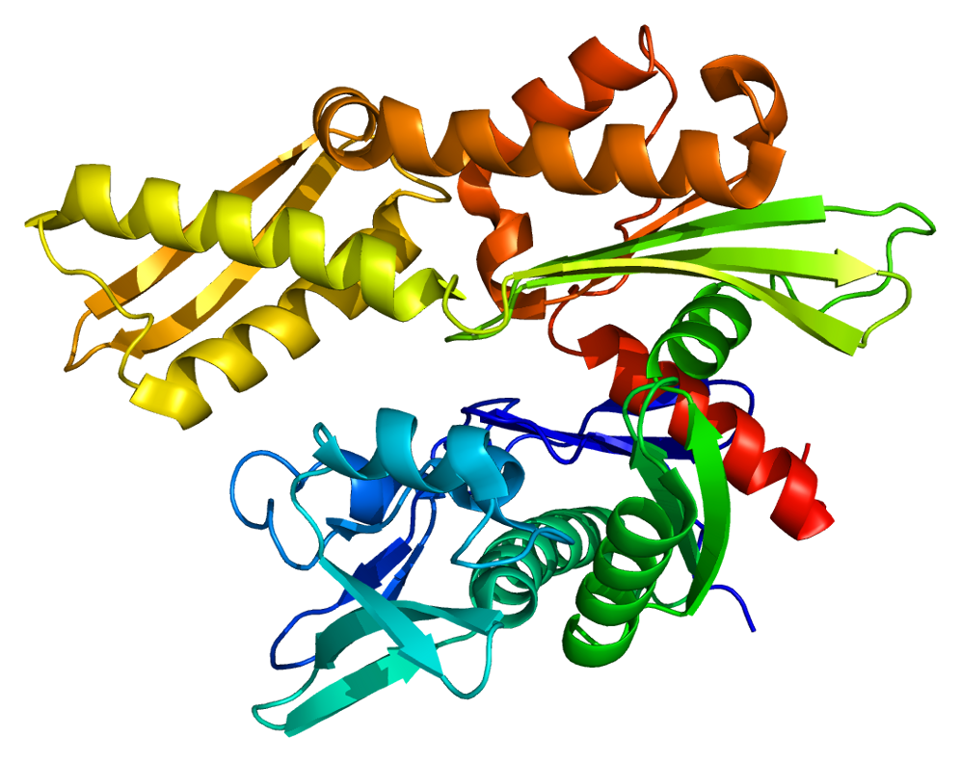
Protein Folding
https://www.youtube.com/watch?v=cAJQbSLlonI

Slide 4
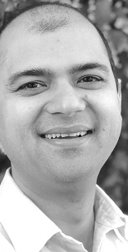
Protein Folding
Prof. Badri Adhikari will give presentations
Wednesday, April 3rd 4:00 ABH 001
Note change in class location!
Monday, April 15th
Here in our classroom

Slide 5
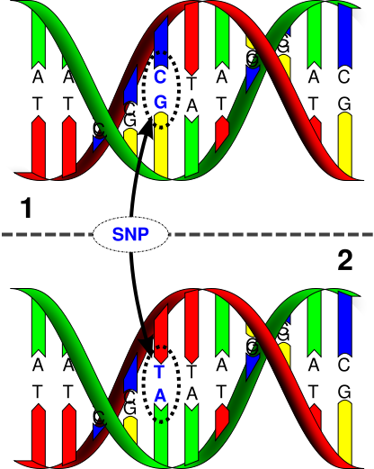
Mutations
Single Nucleotide Polymorphisms (SNPs)
Many causes:
Replication error
Sunlight
Free radicals
Carcinogens
Notes:
Tobacco, lead, asbestos, coal, processed meats, diesel engine exhaust, formaldehyde, plutonium!

Slide 6

Mutations
https://www.youtube.com/watch?v=GieZ3pk9YVo

Slide 7
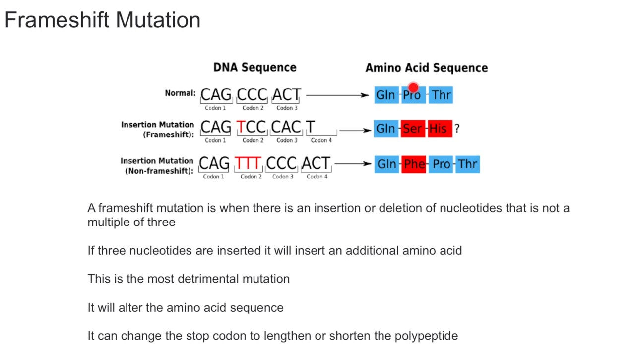
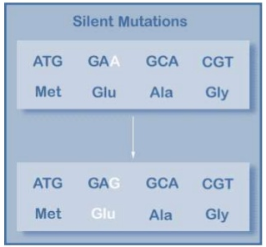
Mutations
What is a frameshift?
When does a mutation to a nucleotide not affect any protein?
Or in DNA region that is never transcribed

Slide 8
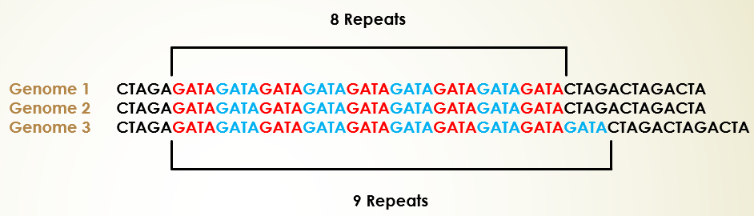
Repetitive DNA
Chunks of DNA that are repeated many times
May be tandem or in different regions of the genome
Over two-thirds of human genome is comprised of repetitive elements
May be beneficial for protein folding
Tandem nucleotide sequences sometimes associated with diseases
Huntington’s disease arises when 40 or more copies of CAG repeat
36 to 39 copies increase risk
Having 28 or more increase risk of adding even more copies during replication
Notes:
Some gene copies become other family members with specialized functions, some become pseudogenes.

Slide 9
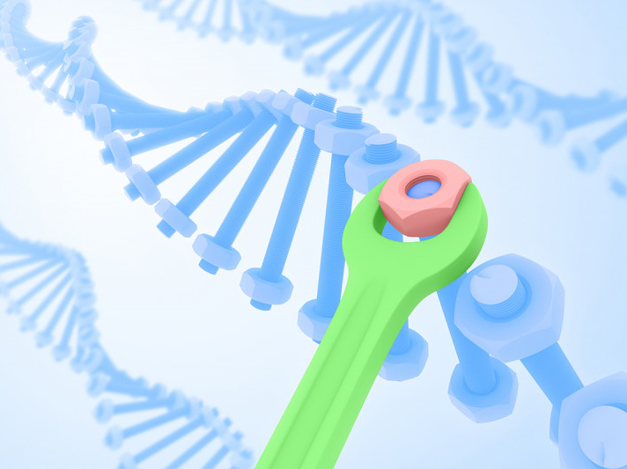
DNA Repair
https://www.youtube.com/watch?v=vP8-5Bhd2ag

Slide 10
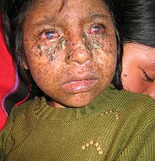
Xeroderma Pigmentosum
Recessive disorder in which there is a decreased ability to repair DNA damage
Mutations in one of 8 or more genes
Affects about 1 in 250,000 in US
1 in 20,000 in Japan
No cure
Treatment: Completely avoid sunlight
More than 40% of cases die by age 20
https://ghr.nlm.nih.gov/condition/xeroderma-pigmentosum
Notes:
Called Children of the night, and vampire children
XPC, ERCC2, or POLH are common in US

Slide 11
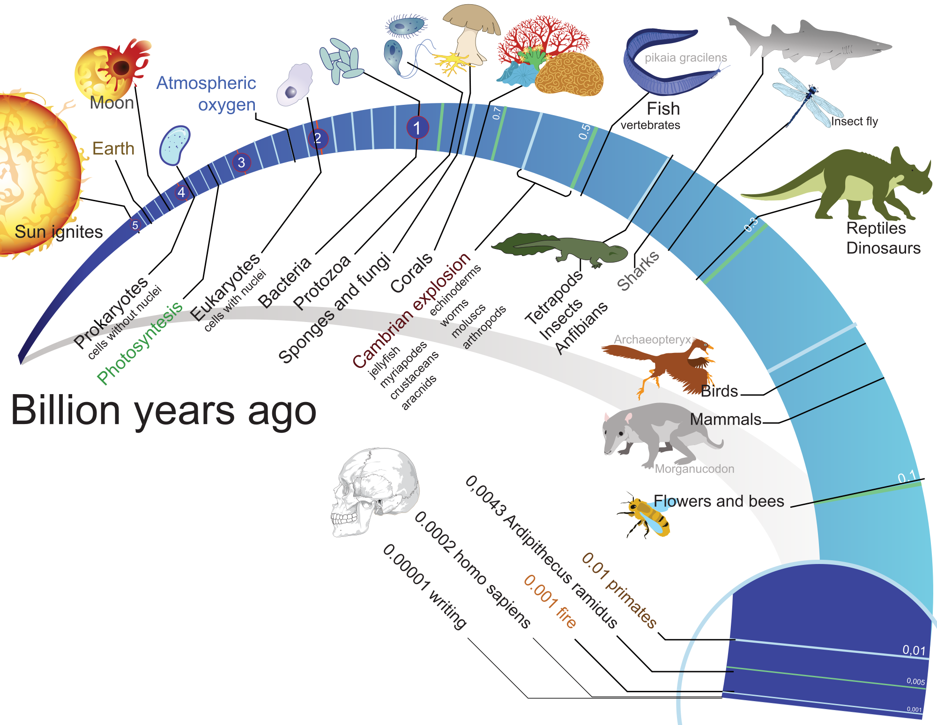
Mutations
Many are neutral
Some are harmful
A few fuel positive evolutionary change

